Slide 1

VIDEO CONTENT EXTRACTION AND ANALYSIS

Slide 2

AGENDA
Project Introduction
Models and Technologies Used
Details of Tools and Applications
Challenges Faced During the Project
Future Improvements and Developments
Conclusions and Results

Slide 3
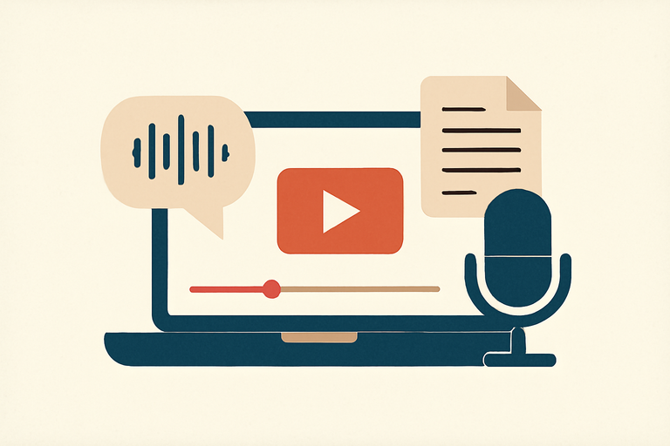
INTRODUCTION
The Speech-to-Text System using Whisper aims to convert speech from sources like YouTube videos into text. It uses advanced models like Whisper for transcription, Chroma for storing transcriptions, and LangChain for querying and retrieving information.

Slide 4
MODELS USED
YT-DLP
Whisper
Chroma
LangChain
Agent
Langsmith
GPT-4
Gradio
Used to download audio from YouTube videos.
Used for converting speech into text.
Used to store the converted texts in a database for retrieval.
Facilitates querying between OpenAI and Chroma for efficient information retrieval.
Enables intelligent interaction with the user to fetch accurate responses.
Used to test the model's performance and ensure response accuracy.
Used for summarizing and translating texts into multiple languages.
Provides an interactive interface for uploading videos, viewing texts, and asking questions.

Slide 5
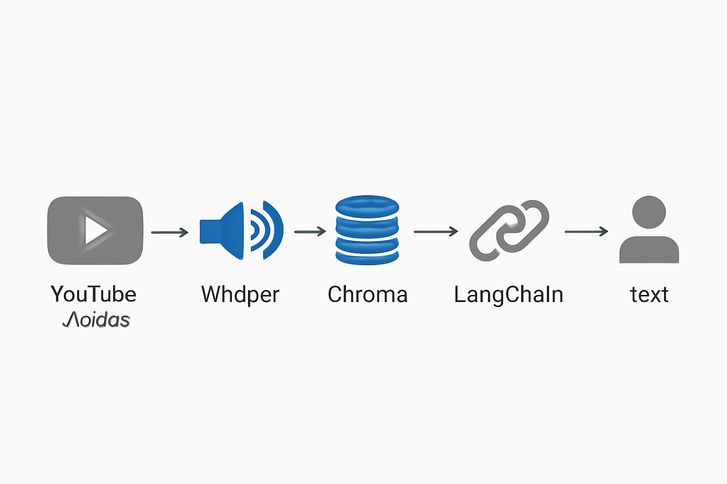

Slide 6
ISSUES FACED
Choosing the right model
Processing delays with long audio files
Slow response time to questions

Slide 7
FUTURE DEVELOPMENTS
Real-time speech-to-text processing
Improve model accuracy with larger Whisper models
Increase speed with parallel processing

Slide 8
CONCLUSION
The system effectively converts speech to text using the Whisper model.
Processing speed has been improved through audio segmentation.
Future work will focus on enhancing accuracy and speed.

Slide 9


Slide 10


Slide 11
Question?

